Slide 1
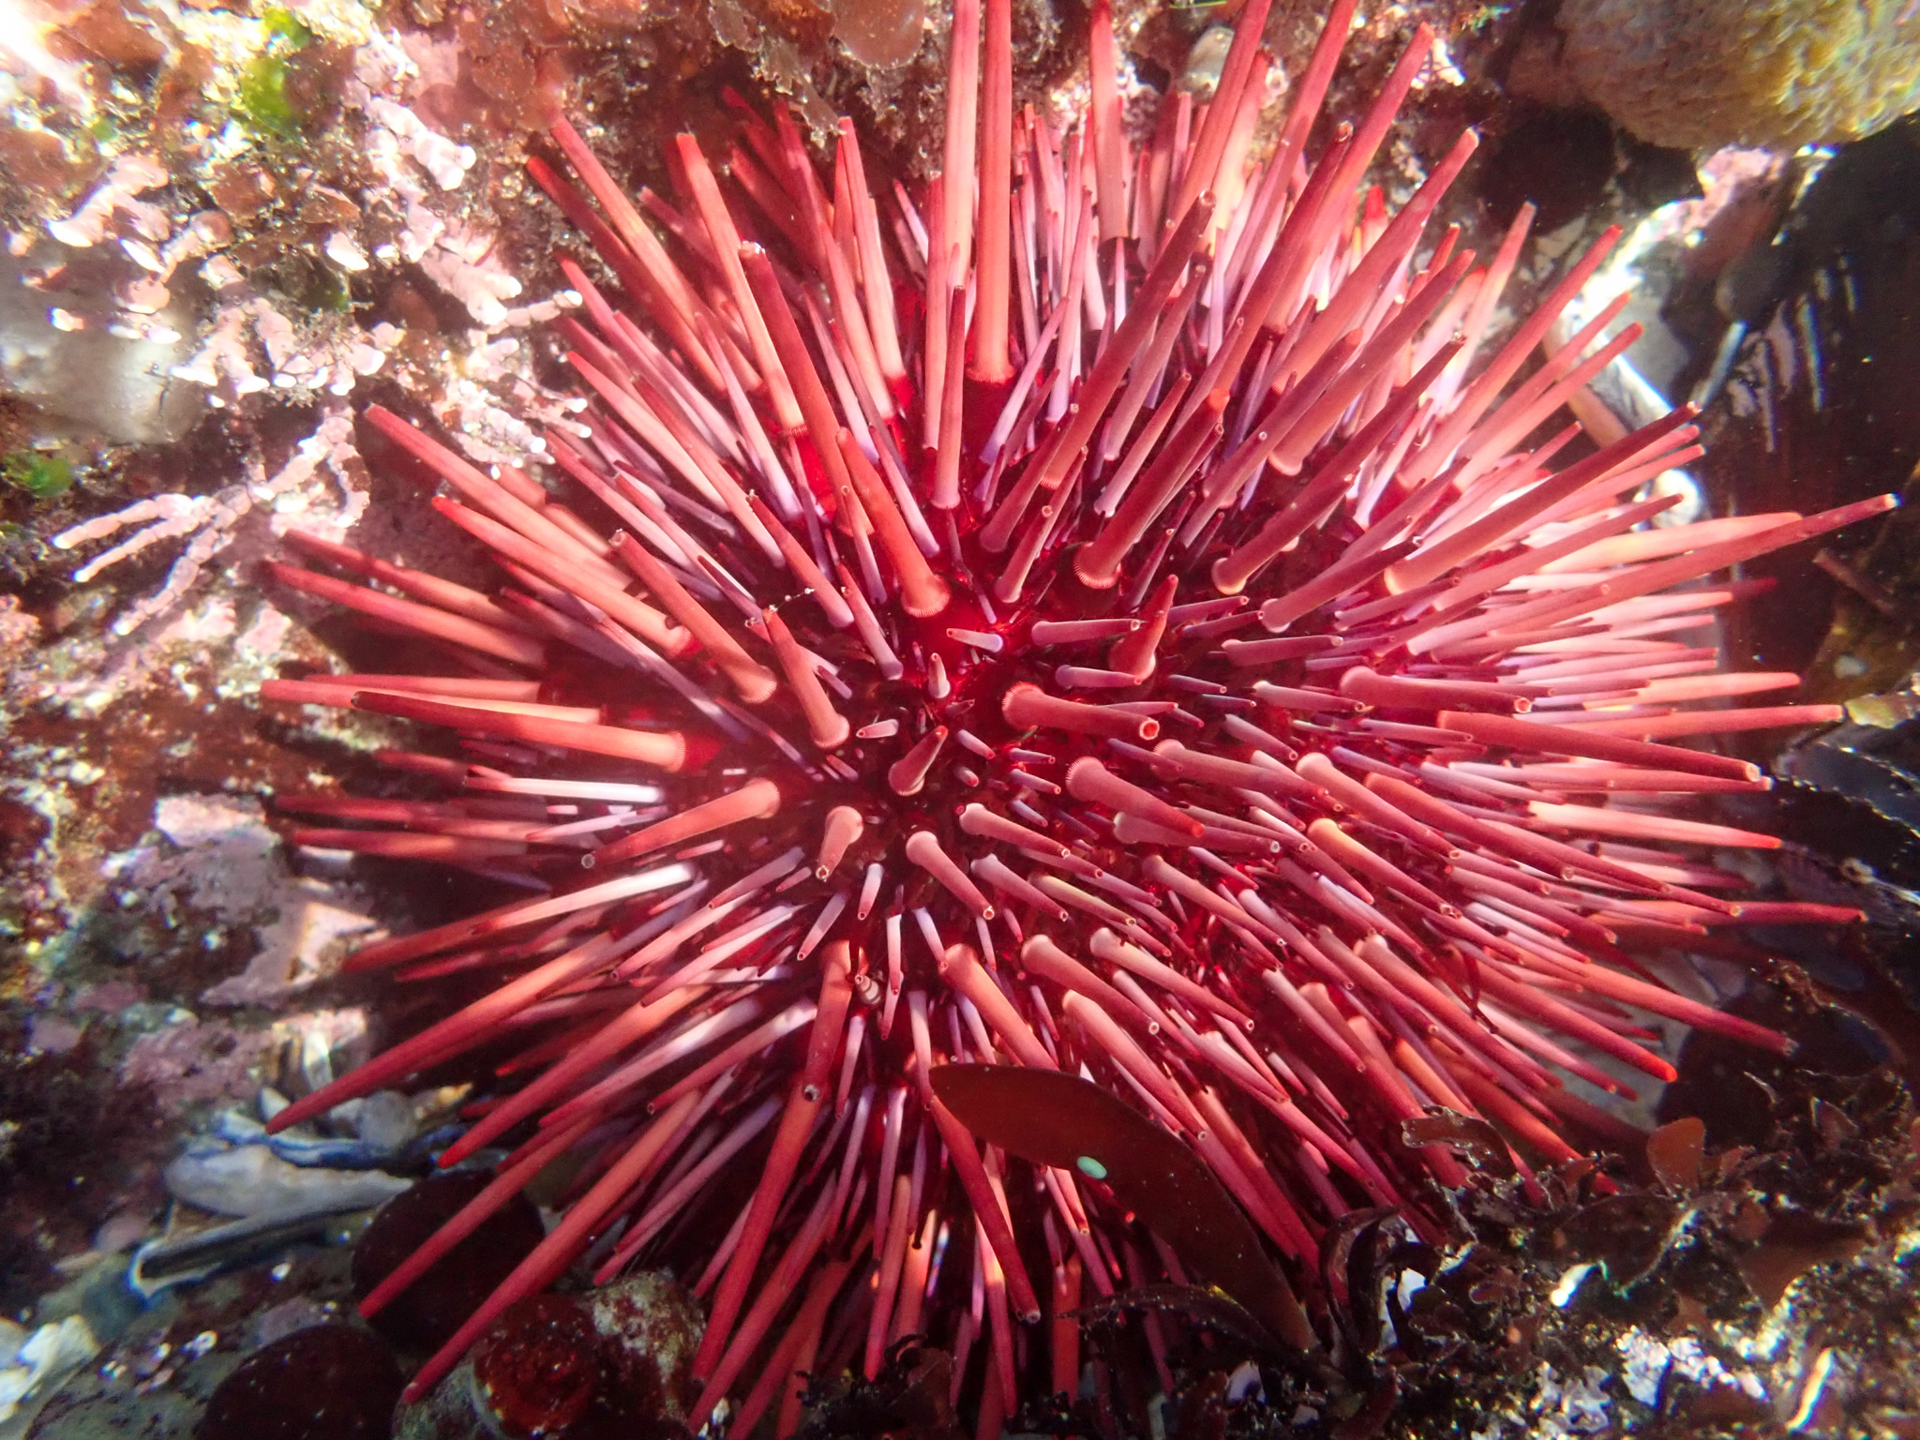
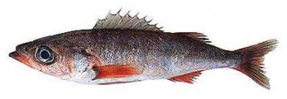
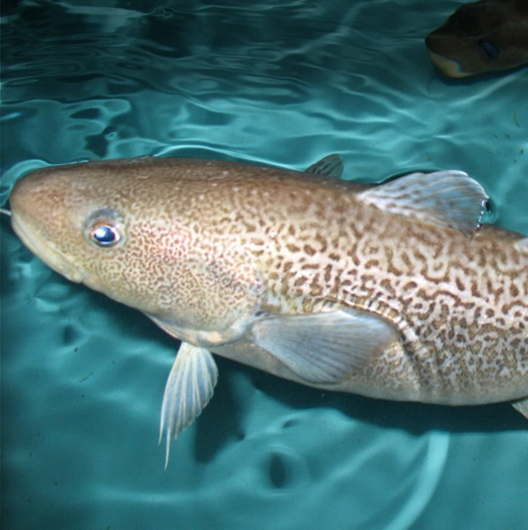
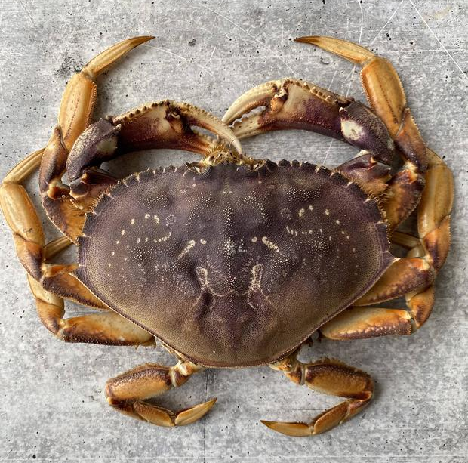
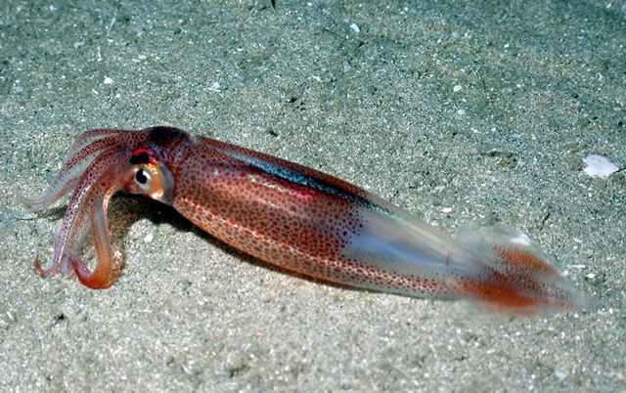
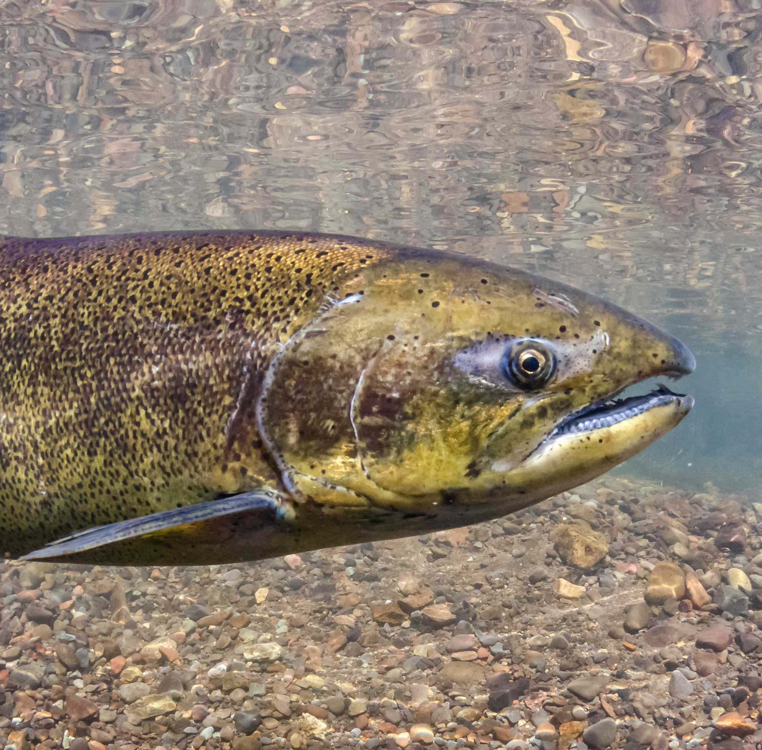
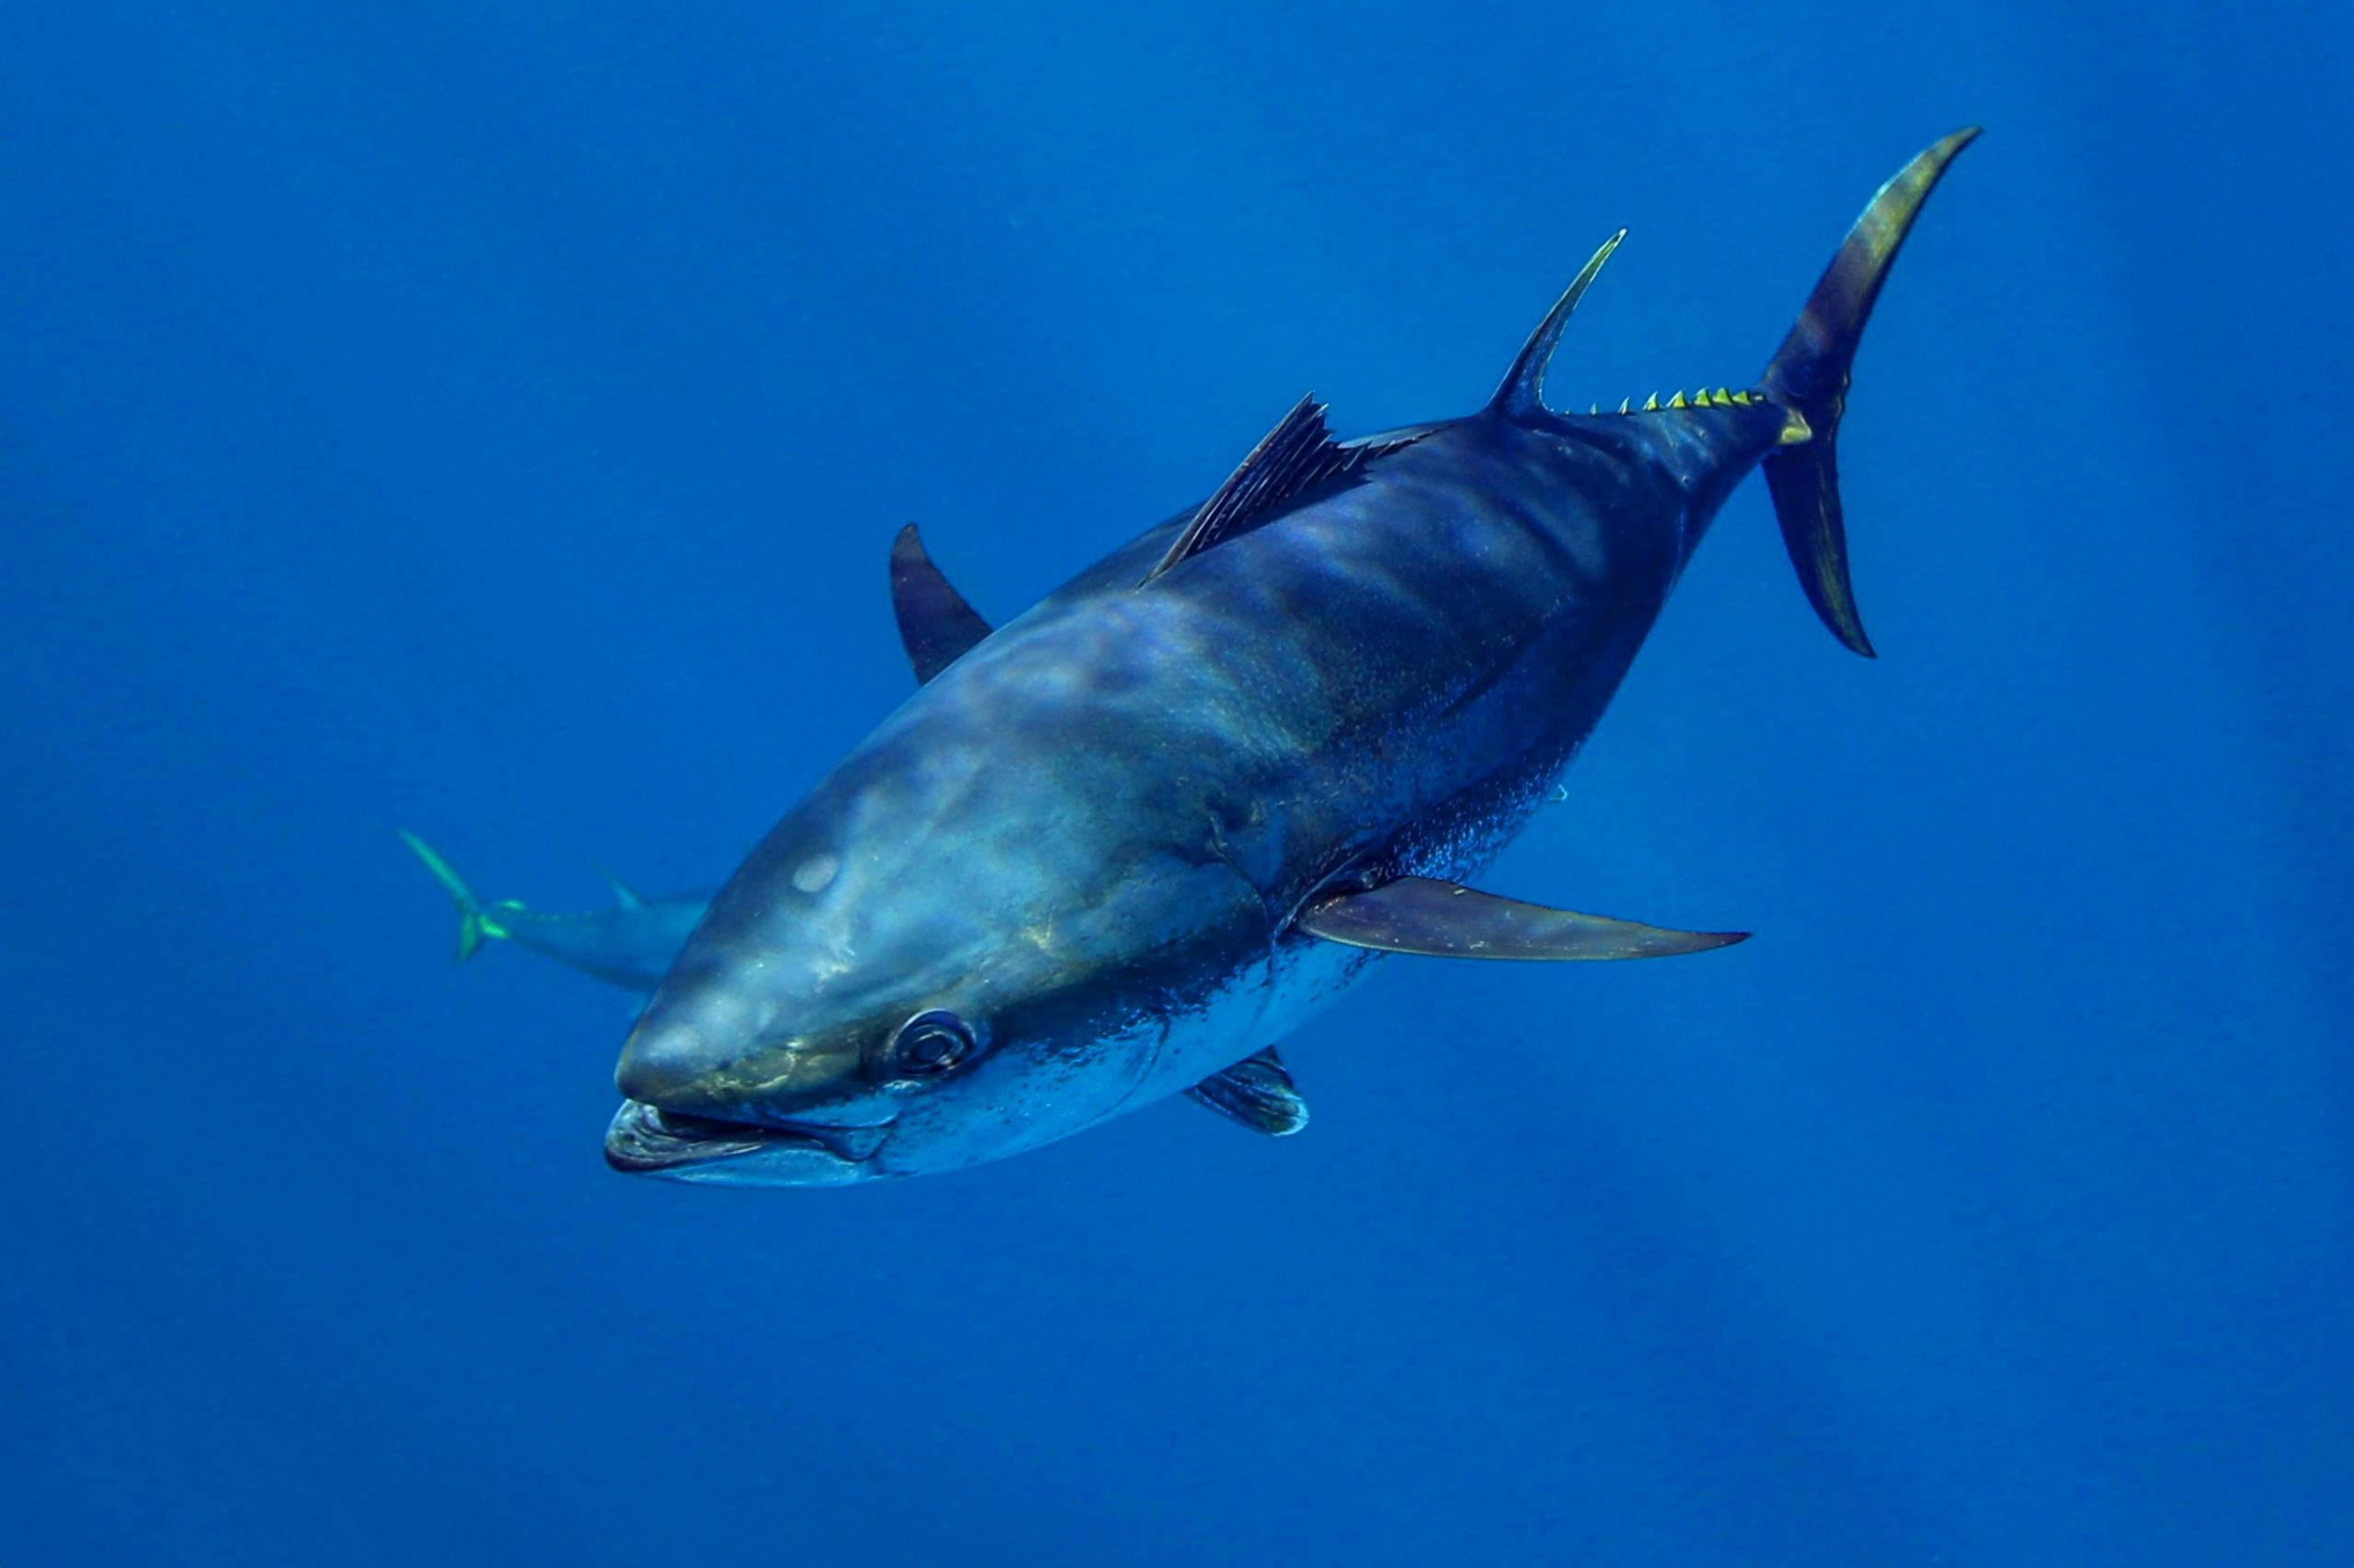
Red sea urchin
Population declines due to loss of kelp beds.
Shortbelly rockfish
Increases in abundance approached bycatch limits in Pacific hake fishery.
Pacific cod
Population declines due to reduced prey and increased metabolic demands.
Dungeness crab
Fishery closures due HABs and whale entanglements.
Market squid
Increases in distribution leads to unregulated emerging fishery.
Chinook salmon
Overfished due to reduced productivity and model failure.
Bluefin tuna
Increased abundance was a boon for the recreational fishing industry.
Direct negative impacts
Indirect negative impacts
Neutral
impacts
Positive impacts, w/ higher mgmt challenges
Positive impacts, w/ lower mgmt. challenges

